Slide 1

Hotel Booking
By :
Shahad Alomayrah

Slide 2
1
2
3
4
5
6
Contents
Overview
Dataset
Data Cleaning
Question
Conclusion
Analysis Result

Slide 3
Overview
The purpose of this analysis cancellations, whether resorts or city hotels, And also knowing the most year and The cancelled month in which it has been Cancelled,
Also knowledge, whether or not a hotel was likely to receive a disproportionately high number of special requests to help devise new methods to reduce the consequent losses.

Slide 4
Dataset
Collected the data from Kaggle website
119390 Rows
32 Columns

Slide 5
Data Cleaning
1
2
Handling Missing Values
Drop Null values
Drop duplicate

Slide 6
Question To Answer
Which are the most cancelled type of hotel ?
Which are the most cancelled year?
Which are the most cancelled month?
Which is the most reserved room type?
Which are the most cancelled Deposit type ?

Slide 7
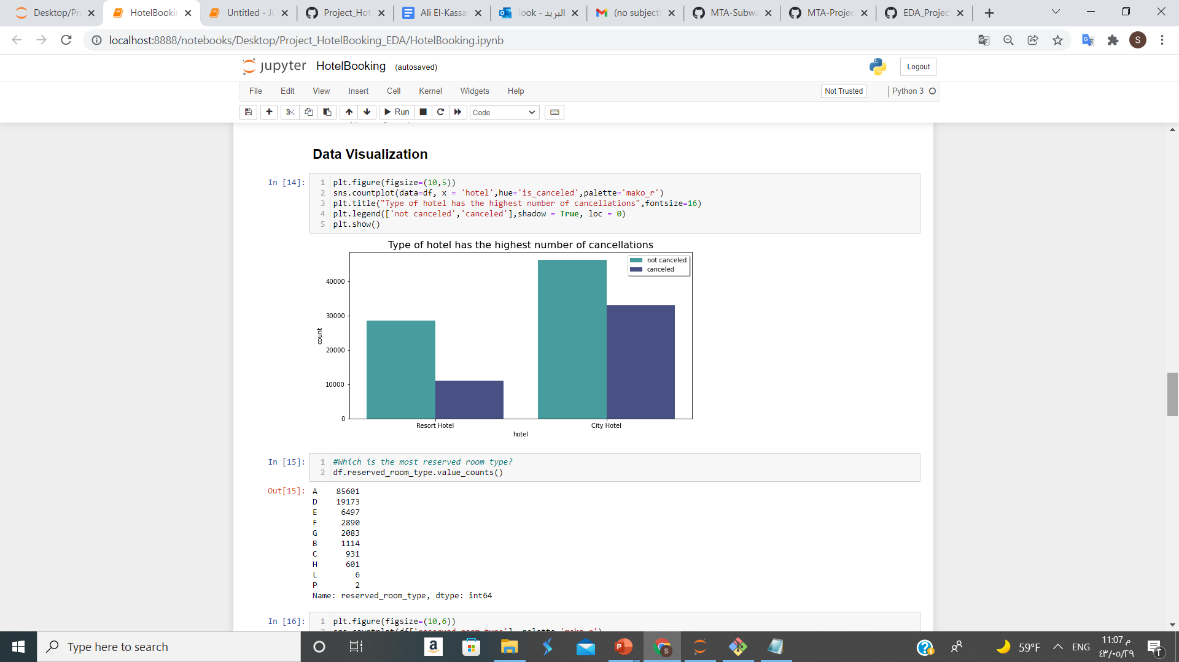
Analysis Result

Slide 8
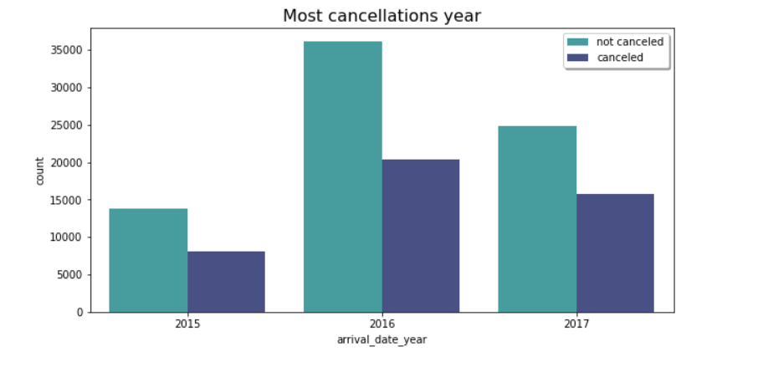
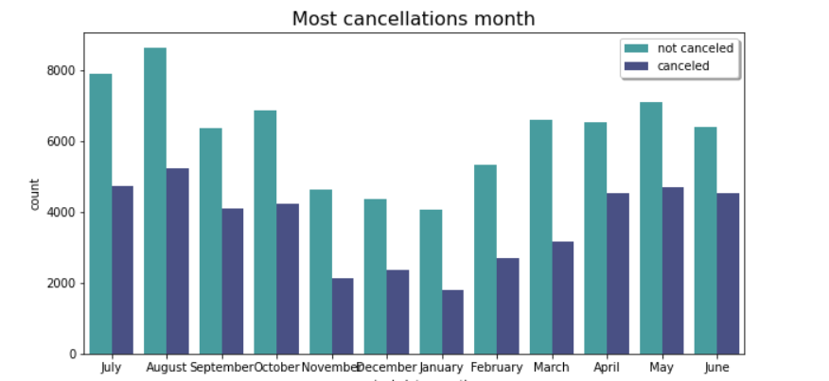

Slide 9
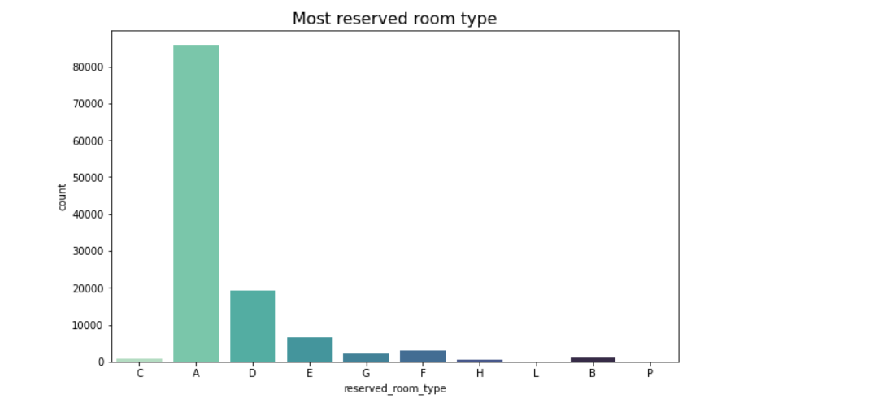

Slide 10
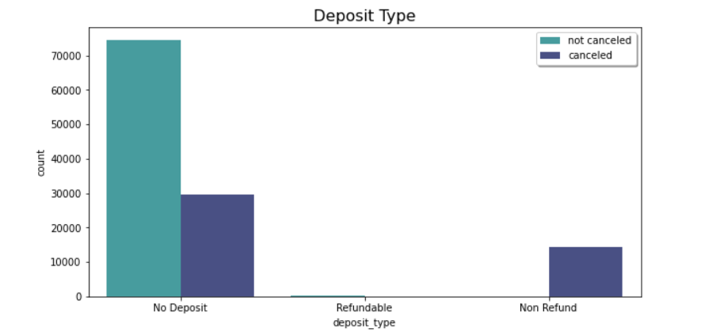

Slide 11
Conclusion
The data were dealt and an analysis Most cancellations are made in a year 2016 , and in a month Aguste , Type of hotel has the highest number of cancellations 'city Hotel ' Also by type of deposit canceled who do not deposit the amount For confirmation of reservation

Slide 12
Thanks
Do you have any questions?

